Slide 1
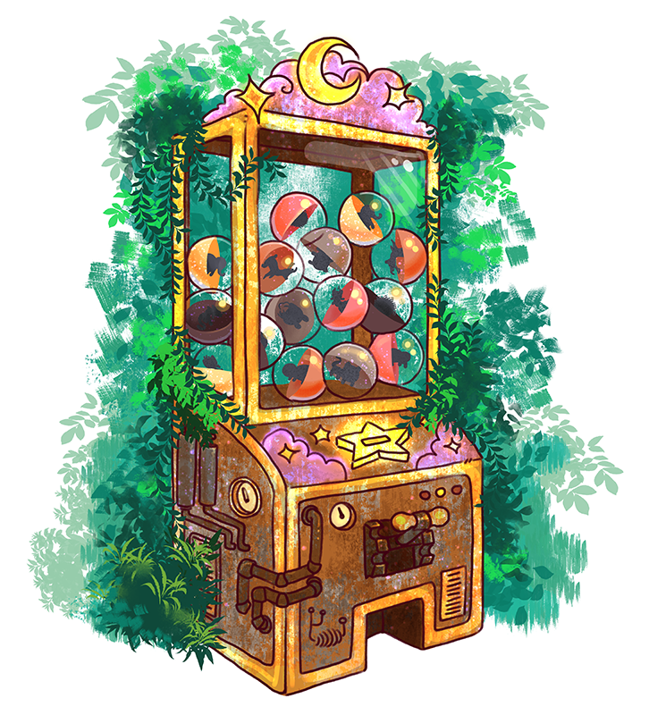
Gacha Collection Beckend
290AA – Advanced Software Engineering
Group: Ardizzoni Francesco Del Castello Diego Prestifilippo Colombrino Mattia Tortorelli Felice

Slide 2
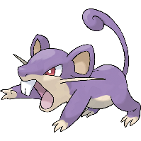






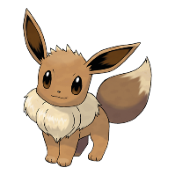




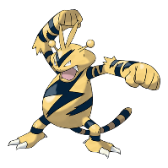
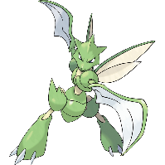
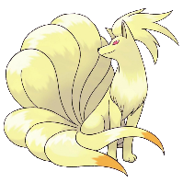


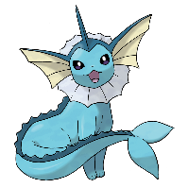

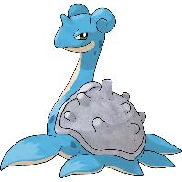

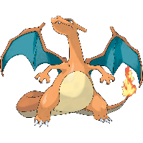

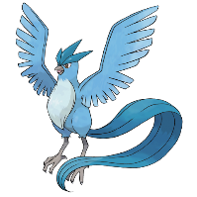

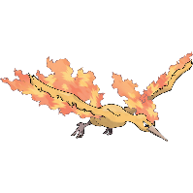
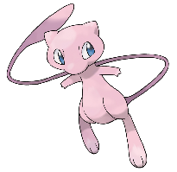
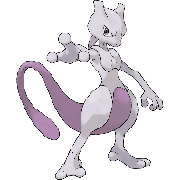
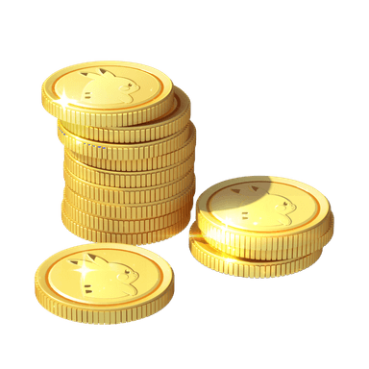

Catalogue – All 151 Pokémon from 1° gen
Common (54,45%)
Uncommon (40%)
Rare (5%)
Epic (0,5%)
Legendary (0,05%)
In-game currency: Pokedollars

Slide 3
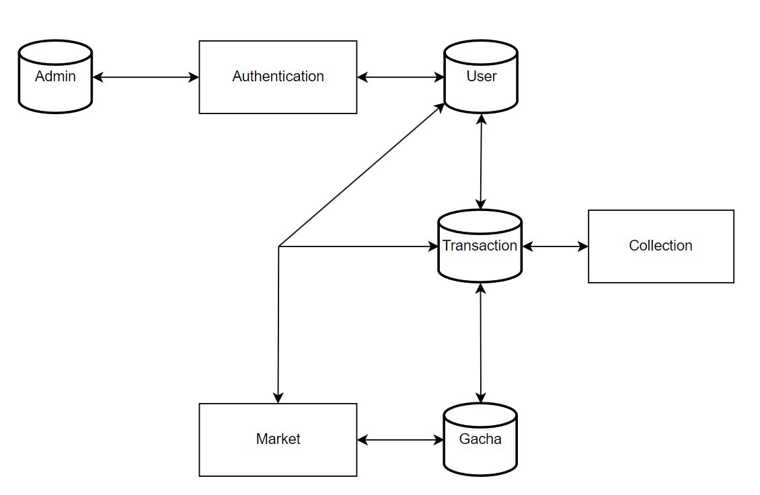
The Architecture

Slide 4
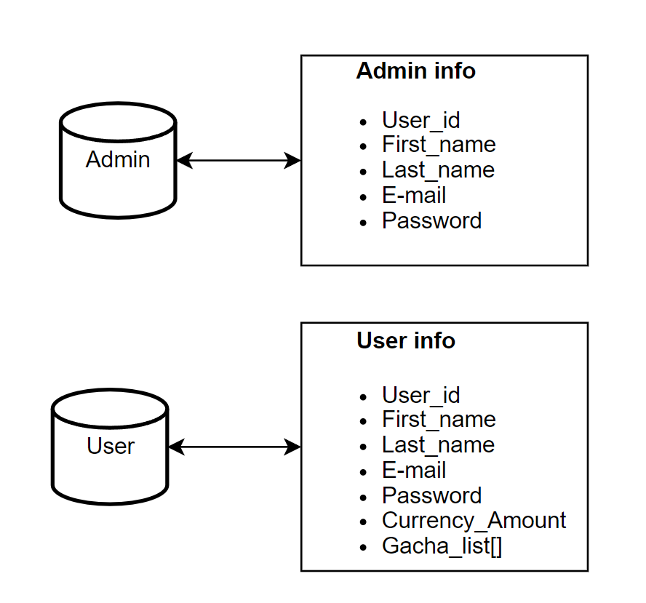
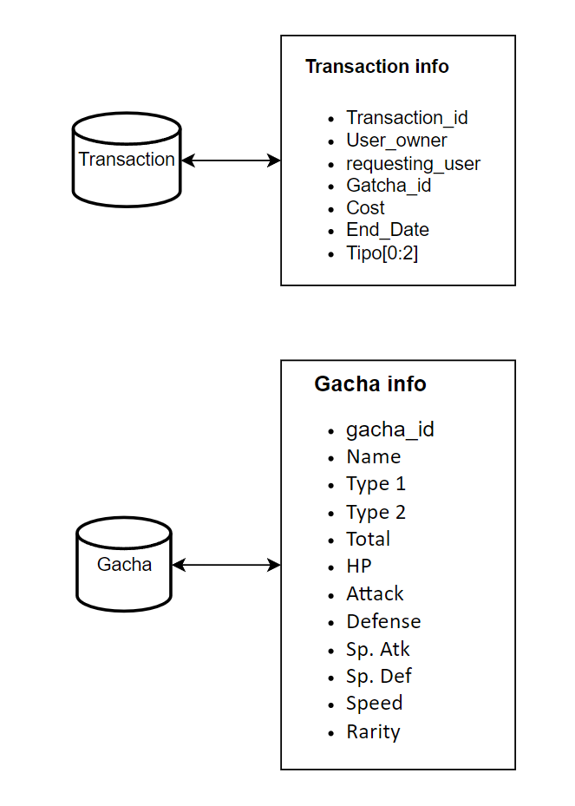
The Architecture

Slide 5
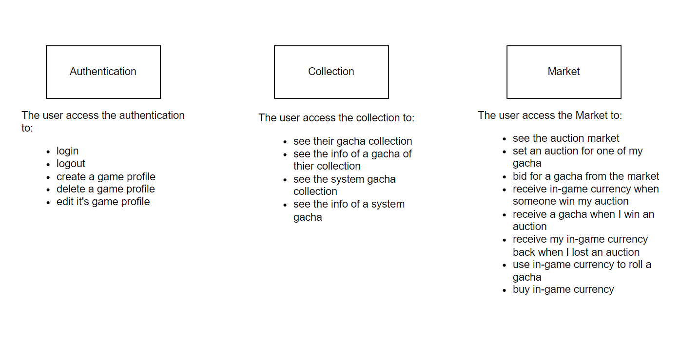
The Architecture

Slide 6
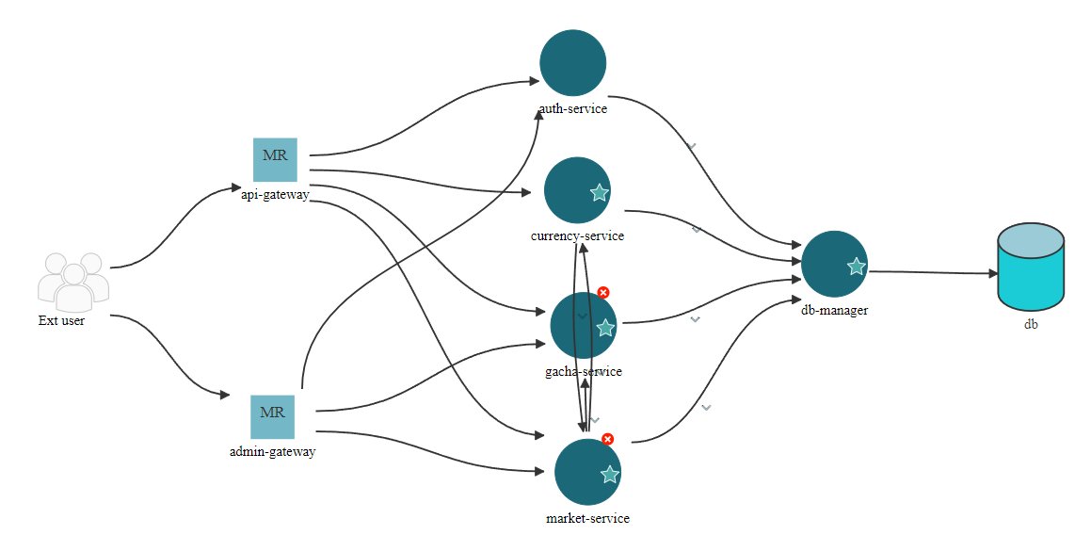
Microfreshener

Slide 7
The micro-services
-api-gateway This API Gateway acts as the main entry point for client requests, forwarding them to the appropriate microservices for processing. It integrates with multiple services.
-admin-gateway
This API Gateway acts as the entry point for admin requests, forwarding them to the appropriate microservices for processing. It integrates with multiple services.
-auth-service This API is part of a microservices architecture and serves as the user management service for the application. It provides operations such as register a new user or authenticate a user
-currency-service
This API is part of a microservices architecture and serves as the currency management service for the application. It provides operations for managing in-game currency and rolling gacha items.
-gacha-service
This API is part of a microservices architecture and serves as the gacha management service for the application. It provides operations for managing gachas and retrieving gacha infos.
-market-service
This API is part of a microservices architecture and handles transactions related to gacha itemsand user purchases. It interacts with other services to track and update user transactions.
-db-manager
This API is part of a microservices architecture and handles all the queries to the database.

Slide 8
The auth service datapath
The auth-related service for the user is exposed externally to clients on port 8000 via an API gateway. The related service for the admin is exposed to clients on port 8080 via an admin_gateway. When an HTTPS request is received for a service related to CRUD operations for authentication, the admin/API_gateway forwards the HTTPS request to the authentication service on port 8001.
The authentication service itself exposes APIs on port 8001 to add, modify, delete update and view an account in the Db.
To interface with the database, the authentication service sends an HTTPS request to the db_manager, which provides APIs for database interfacing services, as perform sql query, and return the result to the authentication service. These database-related APIs are exposed by the db_manager on port 8005.

Slide 9
The currency service datapath
The currency-related service for the user is exposed externally to clients on port 8000 via an API gateway. When an HTTPS request is received for a service related to the operations for currency, the API_gateway forwards the HTTPS request to the currency service on port 8004.
The currency service itself exposes APIs on port 8004 to roll a gacha and buy in-game currency.
To interface with the database, the currency service sends an HTTPS request to the db_manager, which provides APIs for database interfacing services, as perform sql query, and return the result to the currency service. These database-related APIs are exposed by the db_manager on port 8005.
The currency service communicates also with market service to handle operations like creating a new transaction in the market when a roll is done.

Slide 10
The gacha service datapath
The gacha-related service for the user is exposed externally to clients on port 8000 via an API gateway. The related service for the admin is exposed to clients on port 8080 via an admin_gateway. When an HTTPS request is received for a service related to CRUD operations for gacha, the admin/API_gateway forwards the HTTPS request to the gachaservice on port 8002.
The gachaservice itself exposes APIs on port 8002 to add, modify, delete, and view a single gacha, or the entire collection of gachas, or a single or the entire collection of my own gachas.
To interface with the database, the gachaservice sends an HTTPS request to the db_manager, which provides APIs for database interfacing services, as perform sql query, and return the result to the gacha-service. These database-related APIs are exposed by the db_manager on port 8005.

Slide 11
The market service datapath
The market-related service for the user is exposed externally to clients on port 8000 via an API gateway. The related service for the admin is exposed to clients on port 8080 via an admin_gateway. When an HTTPS request is received for a service related to:
USER:
see the auction market, bid for a gacha from the market, view my transaction history, receive a gacha when I win an auction, set an auction for one of my gacha, receive in-game currency when someone win my auction and receive my in-game currency back when I lost an auction operations for currency
ADMIN:
see the auction market, see a specific auction, modify a specific auction and see the market history.
The admin/API_gateway forwards the HTTPS request to the market service on port 8003.
The market service communicates also with currency and gacha services to handle operations like creating a new auction or put a bid on an auction.

Slide 12
The authentication service datapath
User story | Endpoint | Microservices
create my game account/profile | /register /register_admin | admin/api_gateway, auth_service, db_manager
delete my game account/profile | /delete_user /delete_admin | admin/api_gateway, auth_service, db_manager
modify my account/profile | /update_user /update_admin | Admin/api_gateway, auth_service, db_manager
login and logout from the system | /login /login_admin | admin_gateway, auth_service, db_manager
check all users accounts/profiles | /check_users_profile | admin_gateway, auth_service, db_manager
check/modify a specific user account/profile | /update_specific_user | admin_gateway, auth_service, db_manager
check a specific player currency transaction history | /specific_history | admin_gateway, auth_service, db_manager
check a specific player market history | /specific_market_history | admin_gateway, auth_service, db_manager

Slide 13
The currency service datapath
User story | Endpoint | Microservices
use in-game currency to roll a gacha | /roll | api_gateway, currency_service, market_service, db_manager
buy in-game currency | /buy_currency | api_gateway, currency_service, db_manager
have different level of roll rarity | /golden_roll | api_gateway, currency_service, db_manager

Slide 14
The gacha service datapath
User story | Endpoint | Microservices
Check all the (system) gacha collection | /gacha/get | admin/api_gateway, gacha_service, db_manager
check a specific (system) gacha | /gacha/get/<int:gacha_id> /gacha/getName/<string:name> | admin/api_gateway, gacha_service, db_manager
modify the gacha collection | /gacha/add | admin_gateway, gacha_service, db_manager
modify a specific gacha information | /gacha/update/<int:gacha_id> | admin_gateway, gacha_service, db_manager
modify the gacha collection | /gacha/delete/<int:gacha_id> | admin_gateway, gacha_service, db_manager
see my gacha collection | /gacha/mygacha | api_gateway, gacha_service, db_manager
/gacha/mygacha/<int:gacha_id> | /gacha/mygacha/<int:gacha_id> | api_gateway, gacha_service, db_manager

Slide 15
The market service datapath
User story | Endpoint | Microservices
see the auction market | /auction /auction | admin/api_gateway, market_service, db_manager
set an auction for one of my gacha | /new_auction | api_gateway, gacha_service market_service, db_manager
bid for a gacha from the market | /bid/<transaction_id> | api_gateway, market_service, db_manager
view my transaction history | /my_transaction_history | api_gateway, market_service, db_manager
receive a gacha when I win an auction | /bid/<transaction_id> | api_gateway, market_service, db_manager
receive in-game currency when someone win my auction | /bid/<transaction_id> | api_gateway, market_service, db_manager
receive my in-game currency back when I lost an auction | /bid/<transaction_id> | api_gateway, market_service, currency_service, db_manager

Slide 16
The market service datapath (pt.2)
User story | Endpoint | Microservices
see a specific auction | /auction/<int:transaction_id> | admin_gateway, market_service, db_manager
modify a specific auction | /close_auction/<int:transaction_id> | admin_gateway, market_service, db_manager
see the market history | /auction/history | admin_gateway, market_service, db_manager

Slide 17
Market rules
The operations that are possible in the market are:
Roll a gacha;
Create an auction.
The difference between an auction and a normal roll can be seen looking at the attribute ‘UserOwner’ because for normal rolls, it is set to null, representing that the UserOwner was the system. When an user create a new auction, he/she is the UserOwner.
When an user put a bid on an auction, he/she plays the role of RequestingUser.
The owner’s Currency amount is updated immediately and so for the RequestingUser.
roll
auction

Slide 18
Market rules
If some user raise on the bid, he becomes the RequestingUser. The old RequestingUser get his bid back.
In order to bid successfully, you need to have sufficient currency amount and you need to put a bid higher than the ActualPrice. You can’t raise a bid if the last offer is yours. You can’t bid on an auction already closed (EndDate passed). If you bid at the last second of the auction everything is fine.
The last thing that needs to be pointed out is the SendedTo attribute. An admin has the power of close an auction if he wants to. When he does this the SendedTo attribute, in the record where the UserOwner got the gacha, is setted with the RequestingUser ID.

Slide 19
Security - data
Data Encrypted:
Password Hash: Represents the securely hashed version of the user's password.
Salt: A unique random string used to add variability to the password hashing process to prevent precomputed attacks (e.g., rainbow tables).
Database Storing Them:
The user and admin tables in the db_manager service store the password hash and the salt for each user.
Encryption and Decryption Locations:
Encryption:
Performed in the auth_service during the registration using the hash_password function.
The password is hashed using ‘bcrypt’ and a generated salt, which is then Base64-encoded to ensure safe storage and transfer.
2) Decryption:
Strictly speaking, passwords are not decrypted. Instead, during login, the user-provided password is hashed with the stored salt and compared against the stored hash using the verufy_password function in the auth_service.
This approach ensures secure handling of sensitive information across microservices and protects the data at rest in the database.

Slide 20
Security–Authentication and Authorization
Scenario Selected: Centralized Authentication and Authorization
In this system, the utilis acts as a centralized authority for authentication and token generation. The tokens are signed and validated exclusively by the utilis, ensuring consistent and secure handling of access control.
Steps to Validate a Token:
Token Issuance:
The utilis generates a JWT during login or registration.
The token is signed using the secret key stored securely in the secret_key.env file.
The token contains the user’s claims (payload) and an expiration time.
2. Token Validation:
Each microservice requiring authorization:
Retrieves the token from the Authorization header.
Sends the token to the utilis for validation.
3. The auth_service:
Decodes the token using the same secret key.
Checks the payload claims (e.g., expiration, role).
Verifies the token against a blacklist to ensure it has not been invalidated (e.g., after logout).

Slide 21
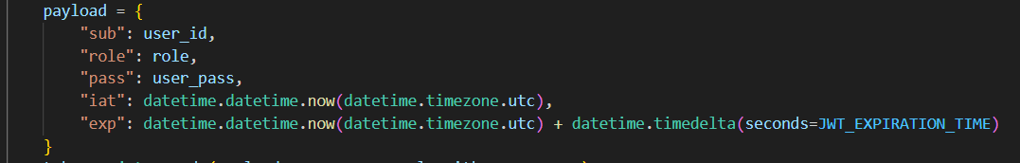
Security–Authentication and Authorization
Access Token Payload Format:
Validation Flow:
Token Issuance:
Input: Email, password → Output: JWT (signed with secret key)
Token Validation:
Input: JWT → Validation: Decode → Verify payload → Check blacklist
Access Granted or Denied:
If the token is valid, access is granted.
If invalid, a 401 Unauthorized error is returned.

Slide 22
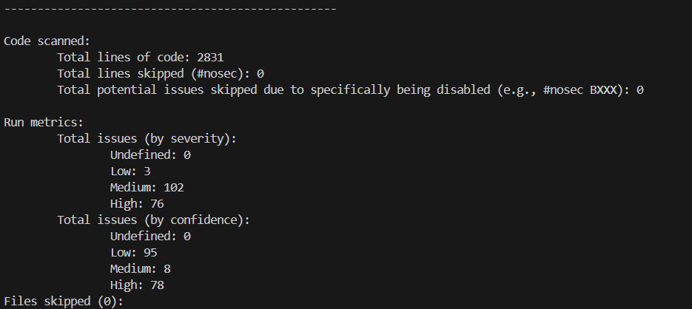
Security – Analyses
Bandit’s final table:

Slide 23
Security – Analyses
Pip-audit final table:

Slide 24
Additional features
User story | Endpoint | Microservices
have different level of roll rarity | /golden_roll | api_gateway, currency_service, db_manager
golden_roll feature gives to the user the chance of rolling a gacha with rarity Epic or higher. Cons: it costs 10 times more than a normal roll.

